Slide 1
ENSE 470 - Milestone 3
Group Name: GLHF
Group Members:
Vincent Chan
Thiago De Melo
Shuaihao Zhao
Joe Emmanuel Samano
January 25, 2018

Slide 2
Future VSM
Notes:
Thiago

Slide 3
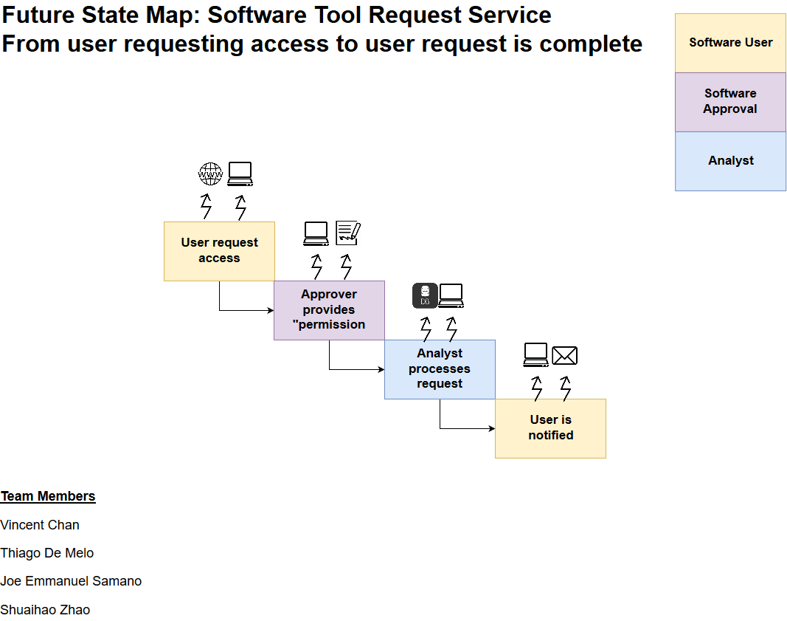
Wrong Approver: Waste Eliminated - User wait time - Over-processing - Unneeded Movement
Different Approval Types: Waste Eliminated - Signature inventory - Over-processing - Signature transportation
Different Approver Files: Waste Eliminated
Defects
Over-processing
File Inventory
Confusing Acronyms: Waste Eliminated
- Defects - Over-processing
Different Submission Types: Waste Eliminated - Submission transportation - Over-processing
Different Means of contact: Waste Eliminated
- Analyst Waiting - Over-processing

Slide 4
User Story Map

Slide 5
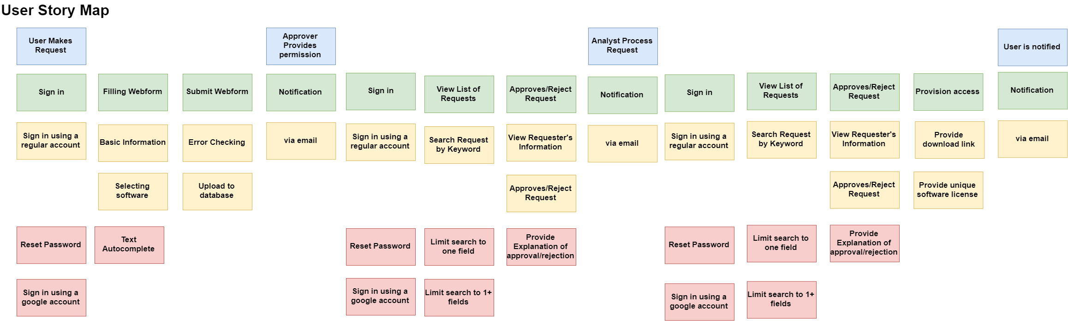
Release 1
Release 2
Notes:
Vincnet

Slide 6
As a user, I would like to make a software request to be able to use a particular software.
As a user, I would like to have an account to sign in, so I can track my software requests easier.
As a user, I want to fill in a webform electronically to conveniently submit my request.
As a user, I prefer filling the application from with
error checking function, so I may not miss
some important information.
Release 1
Release 2

Slide 7
As an approver, I would like to provide permission to a software request electronically, to process these software request faster.
As an approver, I would like to receive notifications (via email) to swiftly process these requests.
As an approver, I would like to have an account,
so I can see all of my requests that requires my permissions.
As an approver, I would like to search a particular
request quickly, so I can give the permission
based on the priority.
Release 1
Release 2
Notes:
Joe

Slide 8
As an analyst, I would like to process the request electronically, to conveniently process these software request in a straightforward way.
As an analyst, I would like to have an account to sign in, so I can track all software requests that are available to be processed.
As an analyst, I would to view a requester’s information to verify whether the requester is legitimate for the software.
As an analyst, I would like to receive notifications (via email) to swiftly process these requests.
As an user, I would like to receive notifications (via email) to be informed that my software request has been processed
Release 1
Release 2

Slide 9
Changes and Misc.
Made us reconsider our previous understanding of the project
Provided insights/ Forced us to think more of the detail
Notes:
Shuaihao

Slide 10
Group Reflection
How did you feel about this milestone? What did you like about it? What did you dislike?
It was a lot of more difficult and confusing compared to the previous milestones.
After we did the user story, it became clearer for us to visual the whole project.
It was difficult, confusing, and time-consuming.
What did you learn about yourself as you collaborated and worked through this milestone?
We learn to create a user story map.
How will you use what you have learned going forward?
Can use to help describe the whole process
We could use this experience to apply in our future projects
What “stuff & things” related to this milestone would you want help with?
Basically, what we should include or follow in creating the user story map.

